Slide 1
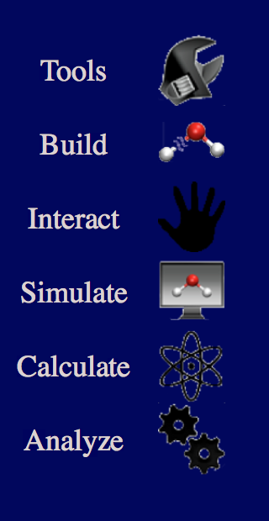

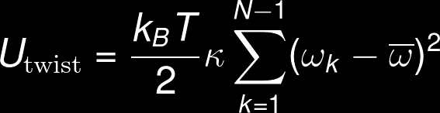

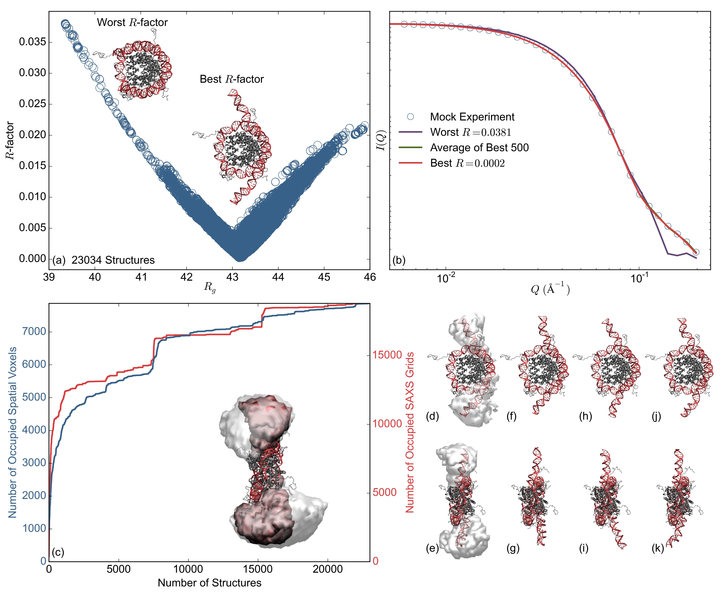
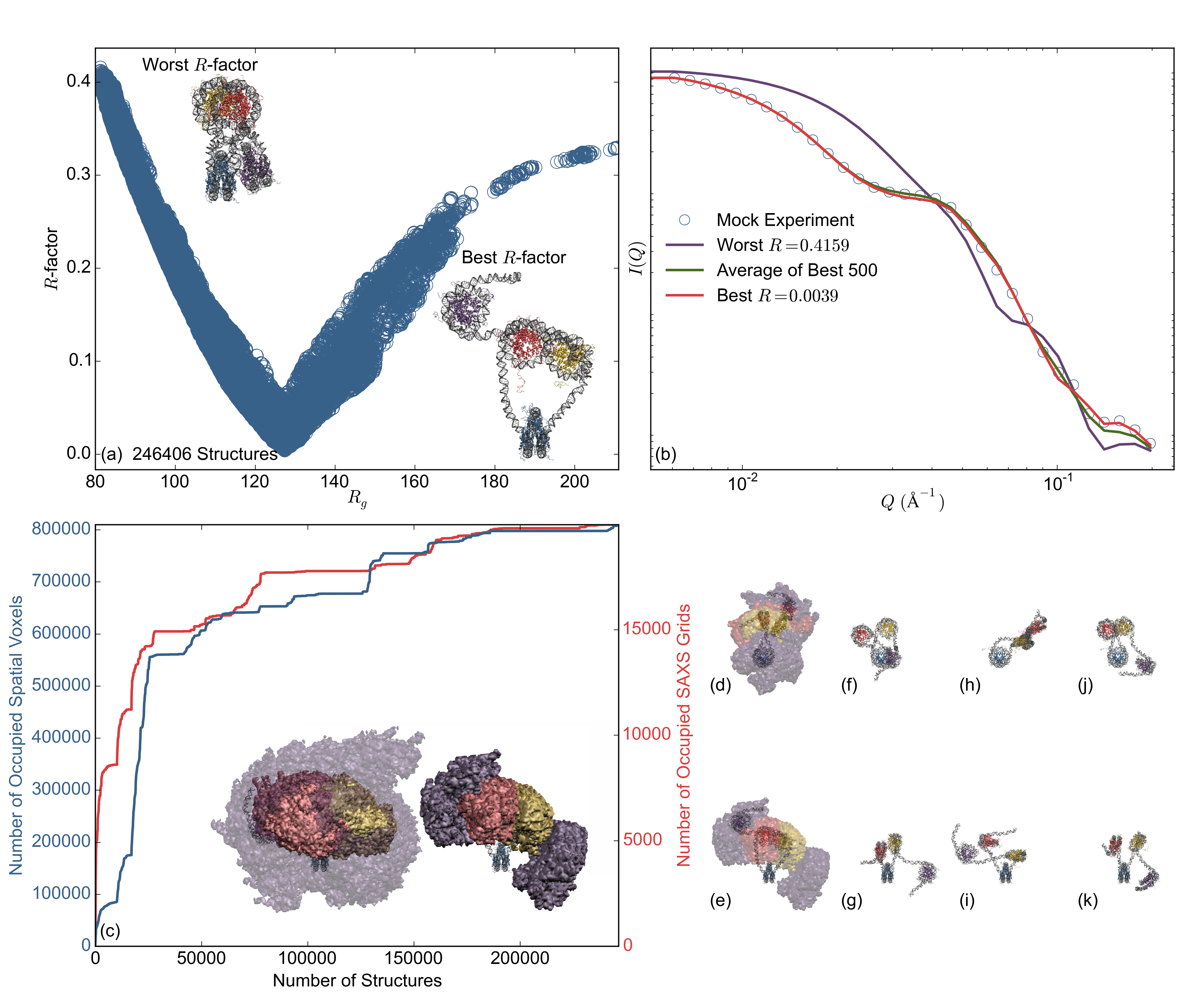

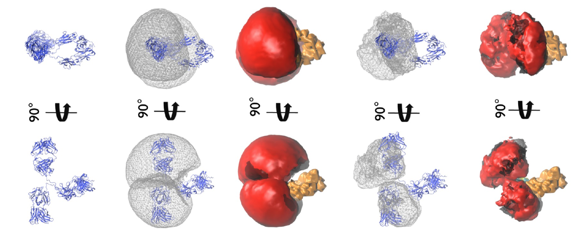




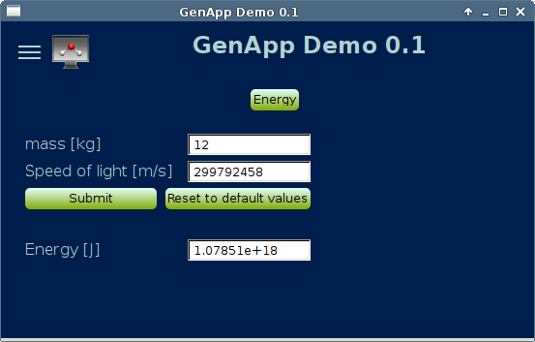
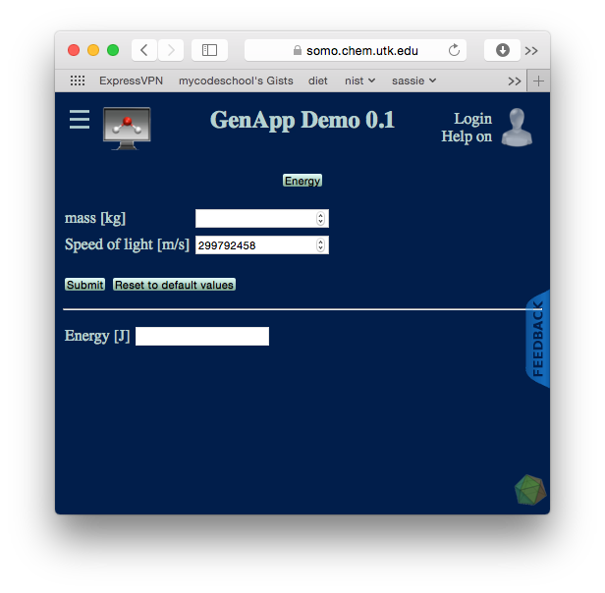

Computational Tools: Atomistic Modeling of Molecular Structures
CCP-SAS provides the infrastructure and tools for analyzing small-angle scattering (SAS) data from complex systems using advanced modeling techniques
Many advanced modeling techniques are not accessible to experimental researchers
Often valuable tools are developed but become unusable when the developer leaves the research group
SASSIE
The CCP-SAS codebase
Consolidated and sustainable code
Easily integrate new modules
Complete workflow for advanced SAS data analysis
Monte Carlo Module for Simulating B-DNA
Metropolis Monte Carlo sampling of B-DNA as a worm-like chain
Rapidly generate ensembles of atomistic structures
Complete SAS Workflow
Contrast Calculator
Align
Data Interpolation
PDB Scan
Molecular Viewer
Monomer Monte Carlo
Complex Monte Carlo
Energy Minimization
Docking (alpha)
SasCalc (beta)
Capriqorn (alpha)
SCT Calculate
SCT Optimize
Chi-Square Filter
SCT Analyze
Extract Utilities
Merge Utilities
PDB Rx (alpha)
Torsion Angle Monte Carlo (beta)
Torsion Angle Molecular Dynamics
Two-Body Grid
SLD MOL
EM to SANS
Crysol
Density Plot
APBS
SAS Probes
Molecular Structure
E=mc²
Demo Application:
Molecular Structure
Function
Python: Accessible, Unified, and
Sustainable Codebase
Determines
#!/usr/bin/python
import json
import sys
import StringIO
if __name__=='__main__':
# read input from JSON
argv_io = StringIO.StringIO(sys.argv[1])
json_variables = json.load(argv_io)
# convert input strings to intended type
mass = float(json_variables['m'])
speed_of_light = float(json_variables['c'])
# do science
energy = mass * speed_of_light**2
# format output as JSON
output = {}
output['e'] = energy
print json.dumps(output)
Integrate/wrap existing code
Access lower level languages: Fortran, C/C++, CUDA
Low barrier to entry
Using Python to Create
An Integrated Modular Framework for Atomistic Modeling of Molecular Structures
./bin/energy.py
Rapidly develop, test, and debug new modules
SASSIE
Scalability: Personal to HPC resources
GenApp Framework
Simplify broad deployment
Lower the entry barrier for deploying new algorithms
Steven C. Howell, Emre Brookes, Joseph E. Curtis
Community governance
Run GenApp Compiler
Seamlessly generate GUI applications for a variety of hardware systems, including science gateways
For a list of CCP-SAS publications visit:
http://ccpsas.org/impact.html
This work benefitted from CCP-SAS software developed through a joint EPSRC (EP/K039121/1) and NSF (CHE-1265821) grant.
Presented at the SciPy 2016, 13-15 July 2016
> ./genapp.pl
E=mc²
GUI Definition:
Qt GUI Version
Java GUI Version
{
"moduleid" : "energy”,
"label" : "Energy”,
"executable" : "energy.py”,
"fields" : [
{
"role" : "input”,
"id" : "m”,
"label" : "mass [kg]”,
"type" : "float"
},
{
"role" : "input”,
"id" : "c”,
"label" : "Speed of light [m/s]”,
"type" : "float”,
"default" : 299792458
},
{
"role" : "output”,
"id" : "e”,
"label" : "Energy [J]”,
"type" : "text”,
}
]
}
Preserve scientific code in an evolving software landscape
Open code without onerous licensing
Web-based Features
User registration / login / verification
User file system (download results)
User job management (reattach job w/ inputs & outputs)
Feedback (with job specific reporting option)
Module documentation link on each page
Simple configuration for HPC resources
Airavata
XSEDE (Indiana University)
JetStream
To view live demo visit:
http://somo.chem.utk.edu/demo
Web Version
Rapid GUI Development
./modules/energy.json
1. Modify scientific module to accept and produce JSON input and output
2. Write a JSON definition file describing the i/o requirements of the module
3. Compile script interprets JSON definition file to build standalone and/or web-based user interface
Qt3/C++ and Qt4/C++
HTML5/PHP
Android
SCARF (UK)
Titan (ORNL)
iOS
Java

